Slide 1

AI and the Environment 4:
What are Neural Networks?

Slide 2
Neural Networks
A neural network is very much exactly what it says on the tin.
It is an attempt to mimic the way that brains work:
Your brain is just a huge interconnected group of neurons.
You see something – your brain processes the image and then a thought arrives that tells you what it is.

Slide 3
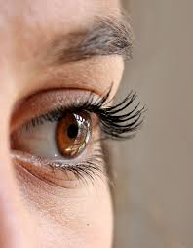
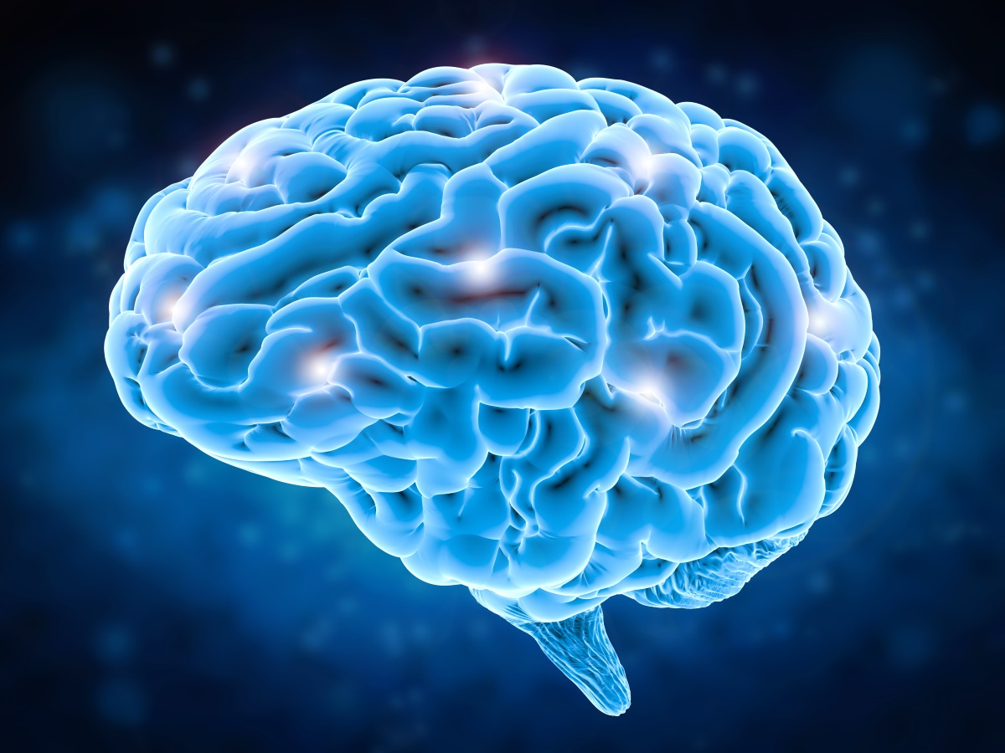
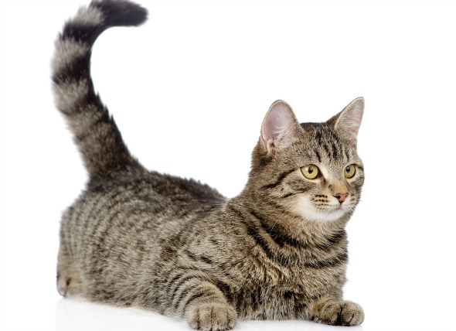
Neural Networks
You see something – your brain processes the image and then a thought arrives that tells you what it is.
Cat!

Slide 4
Neural Networks
You see something – your brain processes the image and then a thought arrives that tells you what it is.
Cat!
Light From object
Rods and Cones
Memory Neurons
Conscious Thoughts

Slide 5
Neural Networks
You see something – your brain processes the image and then a thought arrives that tells you what it is.
Chemical Activation
Activates optic nerves
Chemical Activation
Cat!
Electrical signalling
Electrical signalling
Light enters eye
Light From object
Rods and Cones
Memory Neurons
Conscious Thoughts

Slide 6
Neural Networks
You see something – your brain processes the image and then a thought arrives that tells you what it is.
A neural network has the same exact structure.
Cat!
Input Data
Input Layer
Hidden Layer
Output Layer

Slide 7
Neural Networks
You see something – your brain processes the image and then a thought arrives that tells you what it is.
A neural network has the same exact structure.
Activation Functions
Activation Functions
Activation Functions
Cat!
Feature Engineering
Linear Algebra
Linear Algebra
Input Data
Input Layer
Hidden Layer
Output Layer

Slide 8
Neural Networks
Neural networks are part of deep learning and in general require a huge dataset to learn, much more than other methods and much more than a human needs.
They are the cutting edge and are what are coming up with some pretty amazing results now a days.
They are however as covered before less explainable and more of a black box then other methods.

Slide 9
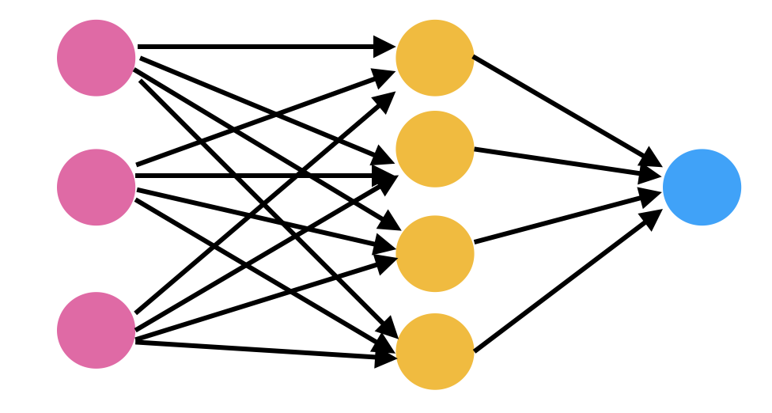
Neural Networks
In general they all follow a similar structure of multiple layers of neurons that pass data to each other.

Slide 10
Neural Networks
What it amounts to is each neuron is a mathematical value that is then multiplied by a series of weights and biases to get the value of the next layers values.

Slide 11
Neural Networks
What it amounts to is each neuron is a mathematical value that is then multiplied by a series of weights and biases to get the value of the next layers values.
w1
b1
w2
w4
w3

Slide 12
Neural Networks
Layers usually have what is termed an activation function applied to them. This is generally some for of mathematical function that transforms the numbers into something within a known distribution.
w1
b1
w2
w4
w3
Sigmoid
Leaky ReLU
tanh

Slide 13
Neural Networks
There are lots of different kinds of neural networks that each excel in different tasks.
The neural network structure we covered already is a standard artificial or feed forward neural network.
We will discuss 3 other kinds of NN, convolutional neural networks (cnn), recurrent neural networks(rnn) and generative adversarial networks(gan).

Slide 14
Convolutional Neural Networks
CNNs are a form of neural network that excel at visual recognition tasks.
They are designed in a way the emulates the visual cortex.
To process an image with a standard neural network it would have to be the size of the total number of pixels.
Instead a CNN takes an area of a picture and correlates it to a smaller number of neurones.
This process is called convolution

Slide 15
Convolutional Neural Networks
CNNs are a form of neural network that excel at visual recognition tasks.
They are designed in a way the emulates the visual cortex.
To process an image with a standard neural network it would have to be the size of the total number of pixels.
Instead a CNN takes an area of a picture and correlates it to a smaller number of neurones.

Slide 16
Convolutional Neural Networks
CNNs take an area of the image and then turn it into a feature map. It may extract features like % of black pixels etc.

Slide 17
Convolutional Neural Networks
CNNs take an area of the image and then turn it into a feature map. It may extract features like % of black pixels etc.
It then pools these together and sub samples within them.

Slide 18
Convolutional Neural Networks
CNNs take an area of the image and then turn it into a feature map. It may extract features like % of black pixels etc.
It then pools these together and sub samples within them.
It repeats this process until it flattens them out into a standard feed forward neural network

Slide 19
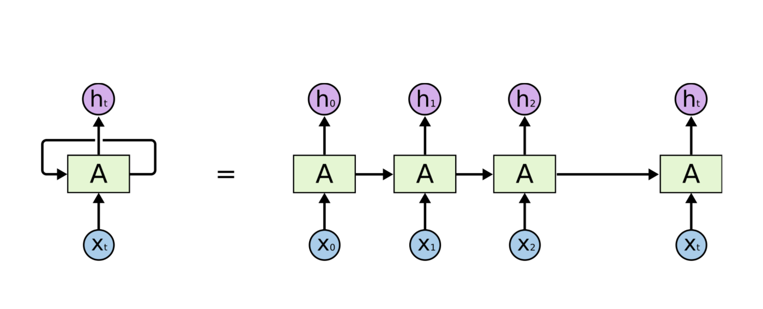
Recurrent Neural Networks
RNNs are neural networks that excel at time series data.
They allow for the allow for information to be maintained between each input data.
i.e the value of the previous input can effect the classification of the current input.
Maintained information

Slide 20
Recurrent Neural Networks
RNNs are neural networks that excel at time series data.
They allow for the allow for information to be maintained between each input data.
i.e the value of the previous input can effect the classification of the current input.
When unwrapped across the time series it shows how this works.
Maintained information

Slide 21
Recurrent Neural Networks
The maintained information is given it’s own weights and biases that allow it to learn.
This means it can learn to recognise patterns within a time series that frequently occur together.
If an animal is performing a specific behaviour at one time step it is likely to be performing it at the next.
Maintained information

Slide 22
Recurrent Neural Networks
There is a form of RNN called a Long-Short term memory RNN.
This is a more complex form of RNN which essentially turns the previous state information into a memory cell.
In its most simple form it introduces a new weight that learns whether or not to forget the previous state information.
Maintained information

Slide 23
Recurrent Neural Networks
There is a form of RNN called a Long-Short term memory RNN.
This is a more complex form of RNN which essentially turns the previous state information into a memory cell.
In its most simple form it introduces a new weight that learns whether or not to forget the previous state information.
Remember information?

Slide 24
Recurrent Neural Networks
LSTM
In its most simple form it introduces a new weight that learns whether or not to forget the previous state information.
In more complex forms it can have memory within each input and between inputs (short and long term memory)
Remember information?

Slide 25
Generative adversarial networks
Generative adversarial networks are very recent and interesting form of neural network.
In principal it is in fact two neural networks.
You have a discriminative network that is learning to classify or predict like an ordinary network.
The generative network is learning to produce fake data in order to trick the first network into classifying wrongly.

Slide 26
Generative adversarial networks
Two neural networks, one network that is learning to classify or predict like an ordinary network. The second network is learning to produce fake data in order to trick the first network into classifying wrongly.
I try and classify whether an image is a cat.
I try and generate fake cat pictures to trick them.

Slide 27
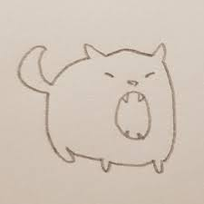
Generative adversarial networks
Two neural networks, one network that is learning to classify or predict like an ordinary network. The second network is learning to produce fake data in order to trick the first network into classifying wrongly.
Not a Cat!
I try and classify whether an image is a cat.
I try and generate fake cat pictures to trick them.

Slide 28
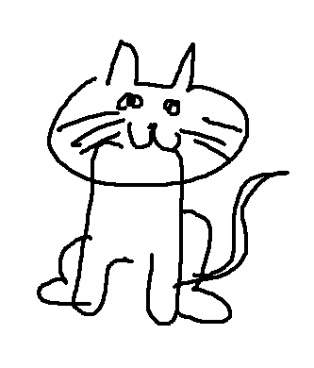
Generative adversarial networks
Two neural networks, one network that is learning to classify or predict like an ordinary network. The second network is learning to produce fake data in order to trick the first network into classifying wrongly.
Yes a Cat!
I try and classify whether an image is a cat.
I try and generate fake cat pictures to trick them.

Slide 29
Generative adversarial networks
Two neural networks, one network that is learning to classify or predict like an ordinary network. The second network is learning to produce fake data in order to trick the first network into classifying wrongly.
Try Again
Yes a Cat!
I try and classify whether an image is a cat.
I try and generate fake cat pictures to trick them.

Slide 30
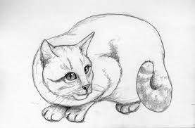
Generative adversarial networks
Two neural networks, one network that is learning to classify or predict like an ordinary network. The second network is learning to produce fake data in order to trick the first network into classifying wrongly.
Yes a Cat!
I try and classify whether an image is a cat.
I try and generate fake cat pictures to trick them.

Slide 31
Generative adversarial networks
Two neural networks, one network that is learning to classify or predict like an ordinary network. The second network is learning to produce fake data in order to trick the first network into classifying wrongly.
Try Again
Yes a Cat!
I try and classify whether an image is a cat.
I try and generate fake cat pictures to trick them.

Slide 32
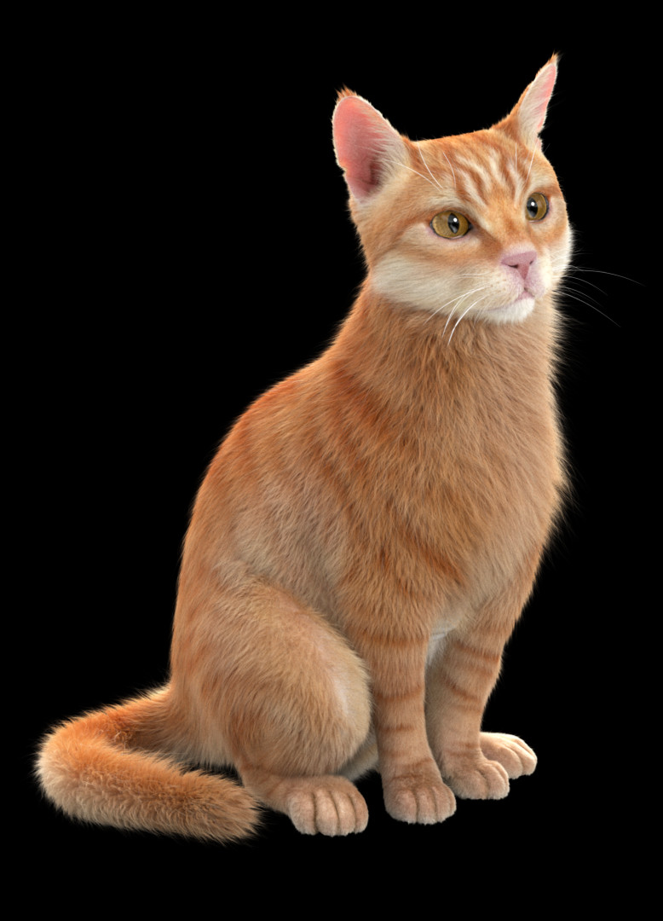
Generative adversarial networks
Two neural networks, one network that is learning to classify or predict like an ordinary network. The second network is learning to produce fake data in order to trick the first network into classifying wrongly.
A few million later
Not a Cat!
I try and classify whether an image is a cat.
I try and generate fake cat pictures to trick them.

Slide 33
Generative adversarial networks
What you end up with are two networks, both highly skilled at their independent task.
A few million later
Not a Cat!
I try and classify whether an image is a cat.
I try and generate fake cat pictures to trick them.

